Slide 1
Student Report Cart Project
Written in Java

Slide 2
What is this software?
This software is about storing each student's Number, Name, ID, subjects' marks, total marks and Roll number in the database.
The subjects are Myanmar, English, Mathematics, Physics, Chemistry and Biology.
This software is written in Java 15 and powered with JavaFX 16.
This software is connected to SQLite which is a relational database management system (RDBMS) contained in a C library. In contrast to many other database management systems, SQLite is not a client–server database engine. Rather, it is embedded into the end program.

Slide 3
How this project is structured?
JavaFX enables us to design with Model-View-Controller(MVC) architecture.
So most of Java files in this project are controllers for FXML files and CSS files which are views.
FXML is the XML-based user interface markup language used in JavaFX applications. CSS describes the look and formatting of a document which is written in that markup language.
The rest of Java files are models and helper classes.

Slide 4
What are inside this project?
This project includes total of 8 Java files, 6 FXML files and 1 CSS file.
Java files are Main.java, Home.java, Add.java, Edit.java, Help.java, Controller.java, DatabaseConnection.java, Student.java.
FXML files are Add.fxml, Edit.fxml, Help.fxml, Home.fxml, About.fxml and Main.fxml.
CSS file is Home.css
There is only one CSS file because this project contains only one window which is also called stage in JavaFX.
Also this project contains some cartoon images which I downloaded from Google.
Let's see what is the role of each file in this project!

Slide 5
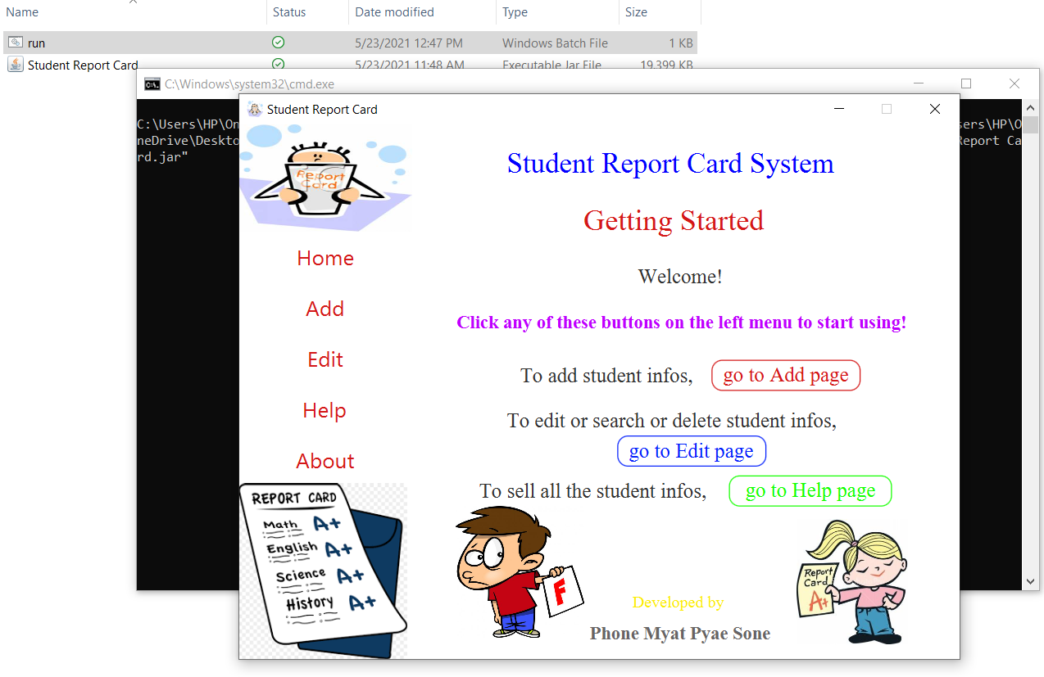
Main.java, Main.fxml and Controller.java
Main.java is the entry point for this application. Normally, this class will create the very first window and starts to load Main.fxml and Home.css files.
Main.fxml is the first UI of the window and it is handled by Controller.java.
How Controller.java handles is that it will also load other fxml files when the user click the buttons on the left menu.

Slide 6
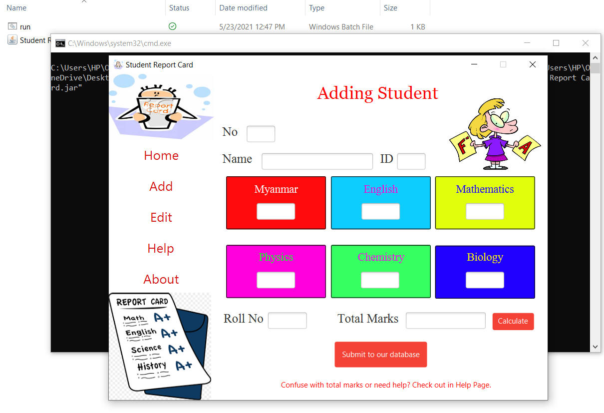
Add.java and Add.fxml
Add.fxml will be loaded when the user clicks Add button on the left menu.
And it is handled by Add.java
Add.java handles all the user inputs in the Add.fxml and it contains two buttons.
The first button is the calculate button which will calculate the all six subjects' marks.
The second button will add the data to the database.

Slide 7
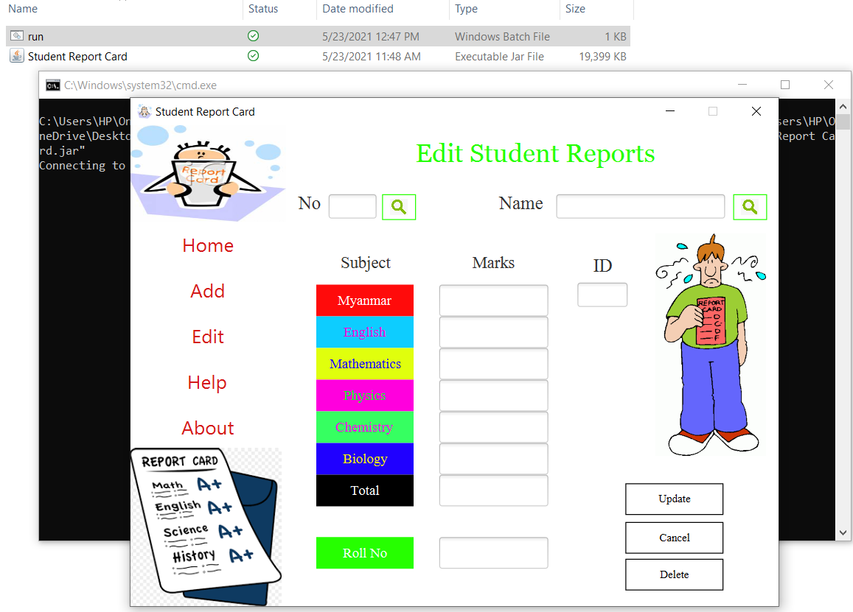
Edit.java and Edit.fxml
Edit.fxml will be loaded when the user clicks Edit button on the left menu. And it is handled by Edit.java
Inputs from the Edit.fxml will be sent to the Edit.java and Edit.java will update or delete the data based on the input.
Edit.fxml contains 3 buttons. Update button will update the existing data in the database. Update button won't work if there is no data that the user want to update in the database.
Cancel button will just clear all the input in the textfields in the Edit.fxml.
Delete button will delete the existing data in the database.

Slide 8
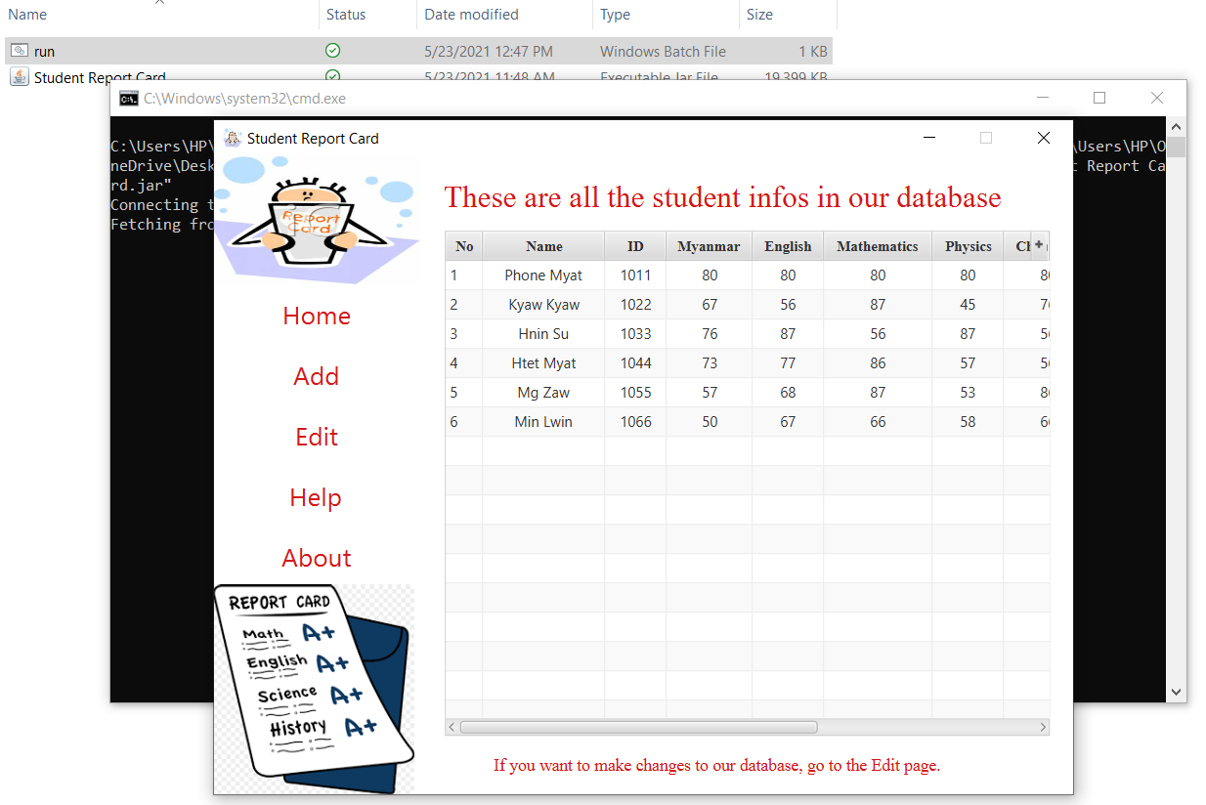
Help.java and Help.fxml
Help.fxml will be loaded when the user clicks Edit button on the left menu.
What you need to know is that those buttons on the left menu are handled by Controller.java
As soon as Help.fxml is loaded, Controller.java will start to fetch all the data in the database and starts to draw the table with the help of table creation code defined in Help.java and basically Help.java will not handle Help.fxml instead it just contains necessary code for creating table and binds the data fetched from the database.

Slide 9
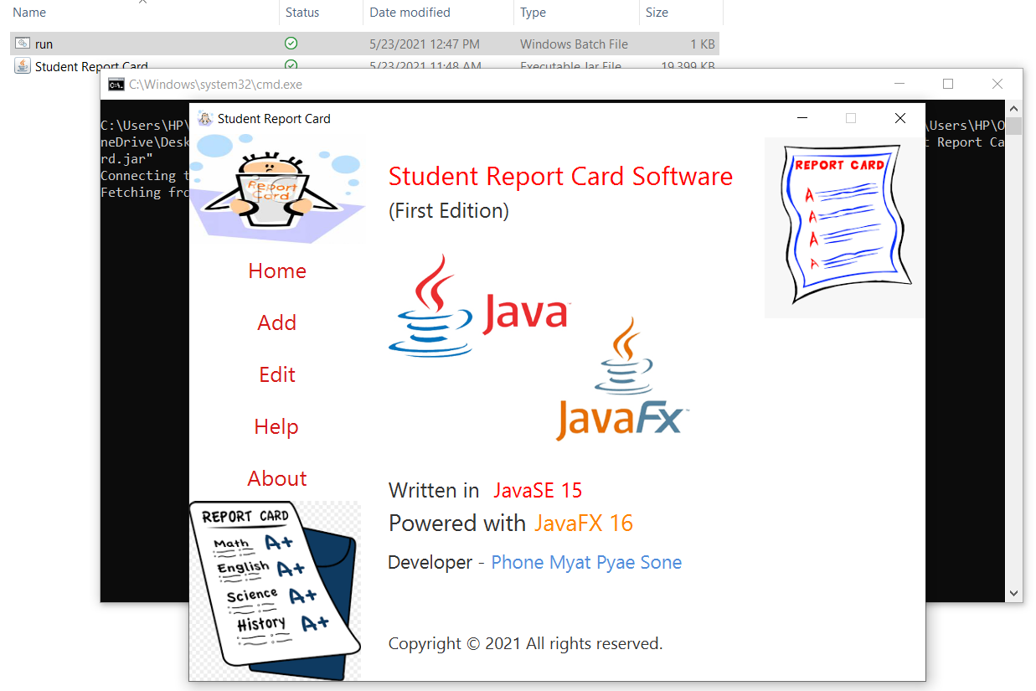
Home.fxml and About.fxml
Both Home.fxml and About.fxml are just for describing the information related to the software.
And they do nothing. So they don’t need controller java files.

Slide 10
DatabaseConnection.java
DatabaseConnection.java is the helper class. What it does is it will help us to connect SQLite database so that we don't have to write the database connection code everytime we want to connect to the database. We just basically instantiate the class. And calling getConnection() will connect to the database.

Slide 11
Student.java
Student.java holds the layout of the data that we use. This class contains 11 private properties which are the data of a student. Also this class contains constructor , getter and setter functions. Getter and setter functions are important because without them, it will be so much difficult to bind those data with each cells in the table. And also these Getter functions are used to write the query for the database.

Slide 12
FxmlLoader.java
FxmlLoader.java is the another helper class. It will help us to load the related fxml file so that we don't need to write code everytime we want to load the fxml file we want. The codes from FxmlLoader.java work in the event functions in Controller.java because mostly Controller.java has to load the necessary fxml file.

Slide 13
Home.css
So Home.css styles all the nodes we used in the scene. CSS in JavaFX is not exactly the same as CSS used in Web Development.
Home.css styles the whole software. Basically, css files are loaded in the scene which holds all the nodes (in this case, they are fxml files which are just nodes in JavaFX).
A stage (window) can have multiple scenes which hold all the nodes. So everytime we click the button on the left menu, we are just changing the node.
A node can be anything. It can be a textfield. It can be a button. It can be a label. All the nodes we use must be the children of one root node. Again that root node can be anything. And that root is attached to the scene which in then, is attached to the stage. That's how JavaFX works.

Slide 14
How many lines of code in this project?
There are around 1000 lines of code in this project. (FXML codes are not included)
Comments are included but they are not more than 100 lines.
FXML codes are written automatically by the SceneBuilder software which is used to create GUI with drag-and-drop features.
You will probably wonder or you may think this project shouldn't have more than 1000 lines of code.
But most of the time, Java codes are generally longer than other languages.
Another factor is that, codes become longer and longer because of handling user inputs.

